Slide 1



UNIT 5; Healthy and green
Self-check 5

Slide 2
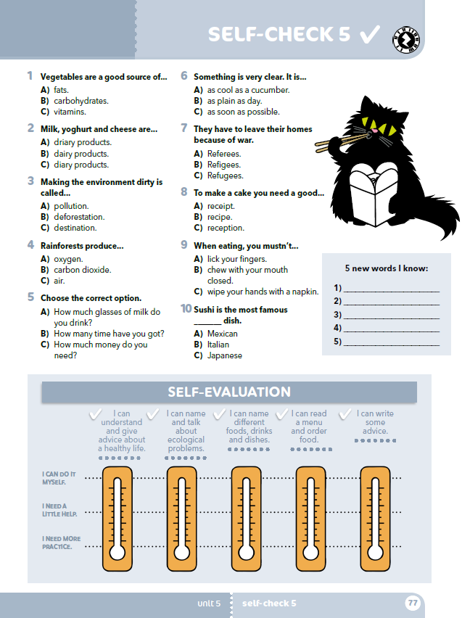
Who is a refugee?
What do you think is the most difficult thing in a refugee’s life?
Why do you think people make fake profiles?
Which posts do you think are not safe / interesting / smart / genuine? Do you sometimes get fed up with social networks? Does it bother you when people slurp while eating or drinking? Do you have a favourite take-away food?
Is pollution dangerous for safe farming?
What can you do to save energy?
What are the ways we can all make this world a better place?

Slide 3

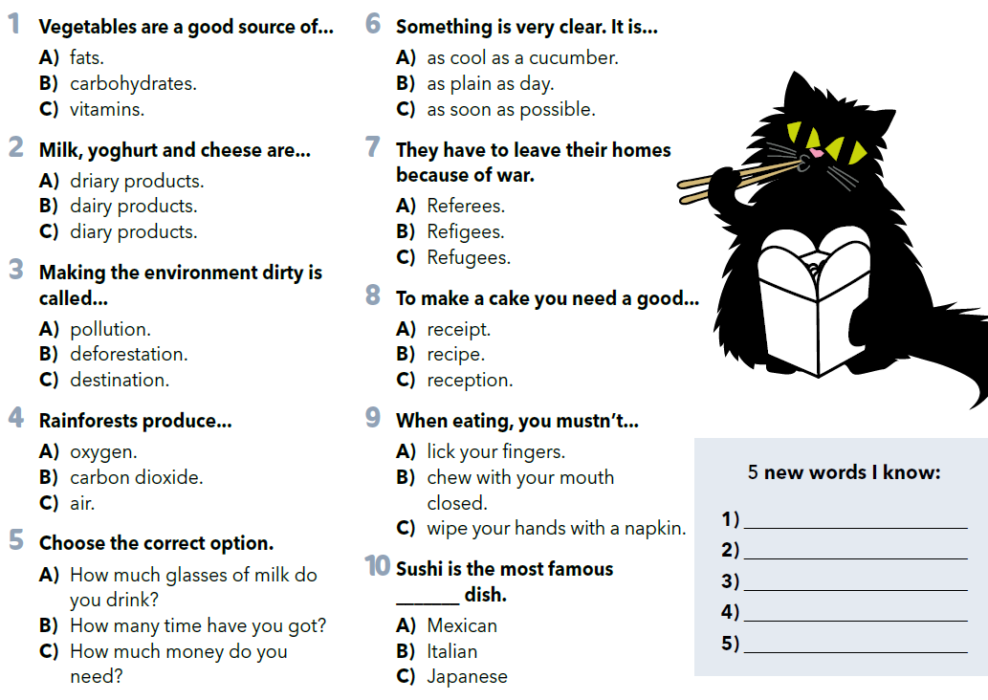


Read the questions and circle the correct answer.
Write 5 new words you know.
Practise: https://wordwall.net/play/925/532/920

Slide 4
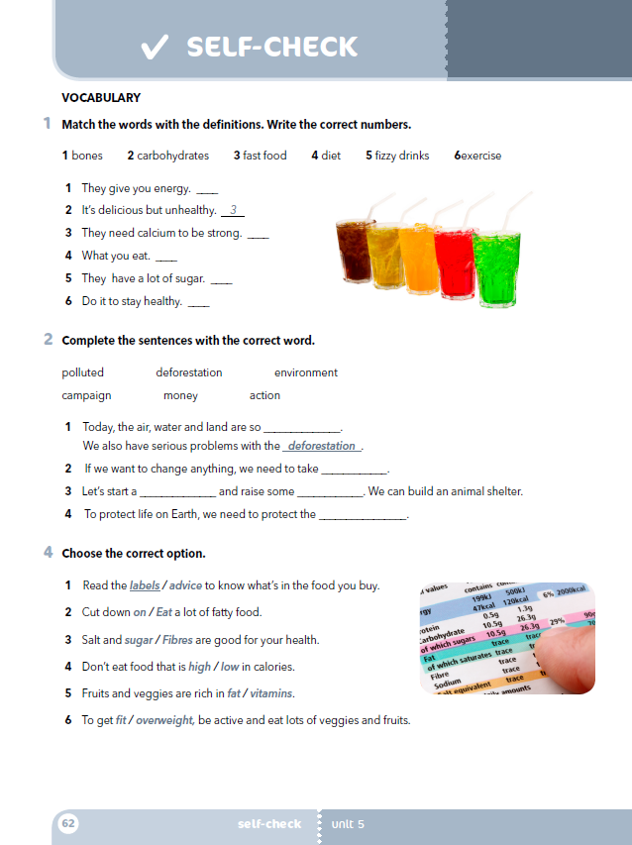
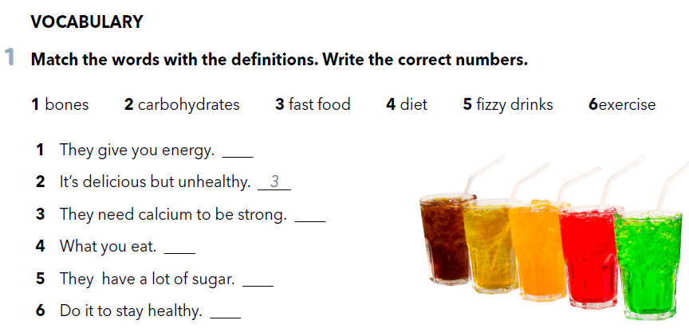
Workbook, p. 62
Match the words with the definitions. Write the correct numbers.
2
1
4
5
6

Slide 5
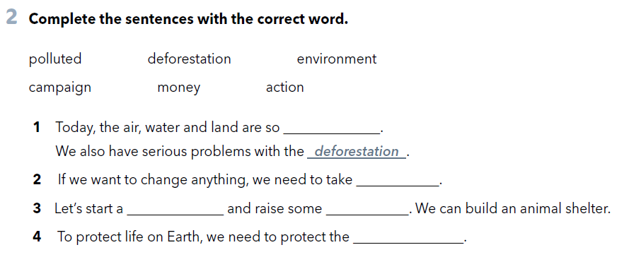
Complete the sentences with the correct word.
polluted
action
campaign
money
environment

Slide 6
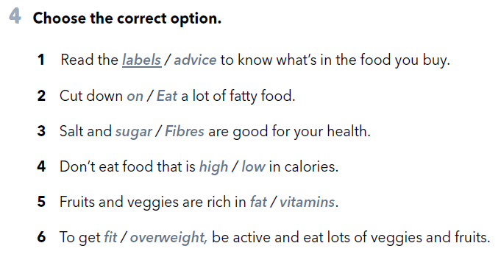


Slide 7
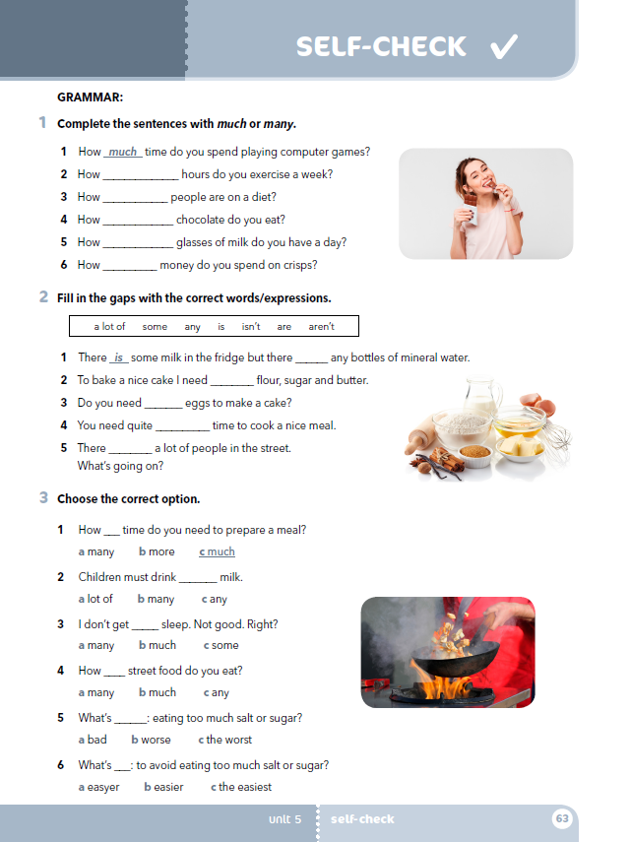
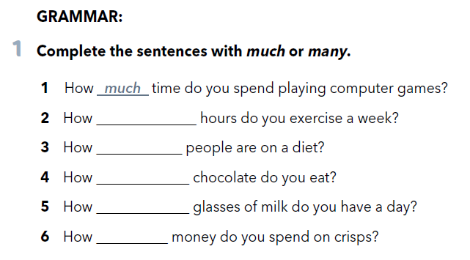
In task 1, page 63, complete the sentences with much or many.
many
many
much
many
much

Slide 8
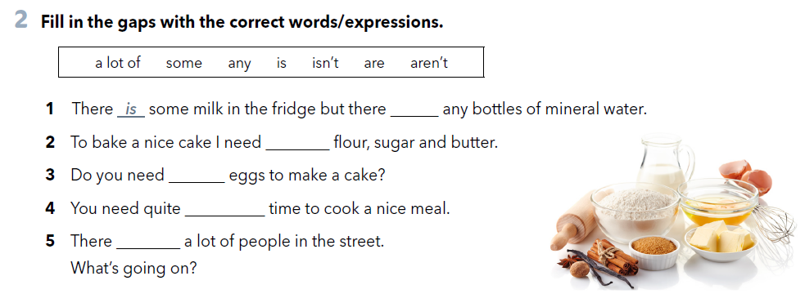
aren’t
some
any
a lot of
are

Slide 9
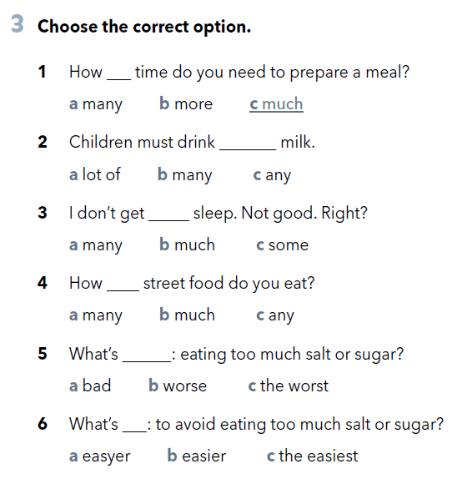

Slide 10

Napiši kratku činkvinu (pjesmu u 5 stihova) o boljem svijetu (A better world) na engleskom! Pravila su jednostavna!
Line 1 - One word, also the title - jedna riječ, naslov; npr. WORLD
Line 2 - Two adjectives that describe the word in line one - dva pridjeva koji opisuju naslov/temu; npr. green, beautiful
Line 3 - Three words that give more information about the subject. - tri riječi koje daju više informacija o temi; npr. our only planet
Line 4 - Four words that show emotion about the subject or individual words or a phrase - četiri riječi koje izriču osjećaje uz temu, ili fraza; npr. build a better world
Line 5 - Synonym of the title or a word very similar to it - istoznačnica naslova; npr. home

Slide 11
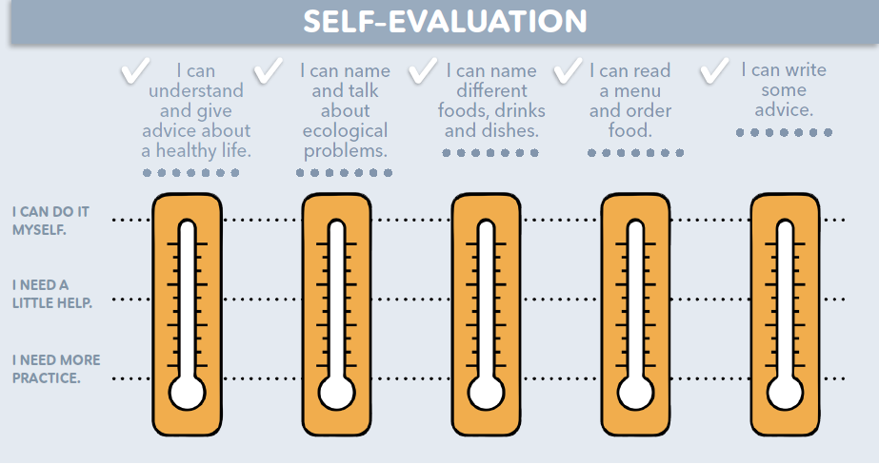
Na toplomjerima označi koliko su ti jasni sadržaji pete teme.
Možeš li razumjeti i davati savjete o zdravom životu? Možeš li imenovati i razgovarati o ekološkim problemima? Možeš li imenovati hranu, pića, jela? Možeš li pročitati jelovnik i naručiti hranu? Možeš li napisati savjet za nekoga?
mogu sam, jasno mi je
trebam malo pomoći
moram još vježbati

